Slide 1

19ECC01 – COMPUTER ARCHITECTURE AND ORGANIZATION

Slide 2
UNIT II - DATA PATH DESIGN
Fixed Point Arithmetic
Addition, Subtraction, Multiplication and Division
Combinational and Sequential ALUs
Robertson algorithm
Booth’s algorithm
Modified Booth’s Algorithm
Restoring and Non–restoring division algorithm
Floating Point Arithmetic
Pipeline Processing
Pipeline Design.

Slide 3
UNIT II - DATA PATH DESIGN
Contents:
Fixed Point Arithmetic |  | Floating Point Arithmetic | Pipeline Processing
Adders | 1-bit Adder n-bit Adder Serial Adder Fast Adders (Carry Save, Carry Select, Carry Look Ahead and Carry Skip Adders) | Addition Subtraction Multiplication Division | Pipeline Structure of Adders, Subtracters and Multipliers
Subtracter | Parallel Adder / Subtracter
Multiplier | 2’s Complement (Robertson) Algorithm Booth’s Algorithm Modified Booth Algorithm Array Multiplier
Division | Restoring Division Non-Restoring Division

Slide 4
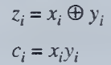
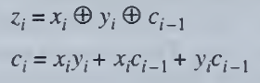
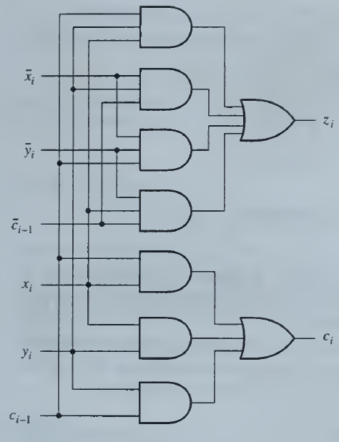
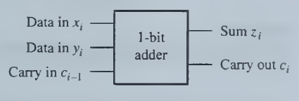
UNIT II - DATA PATH DESIGN
Addition and Subtraction:
Basic Adders
1-bit Half Adder
1-bit Full Adder

Slide 5
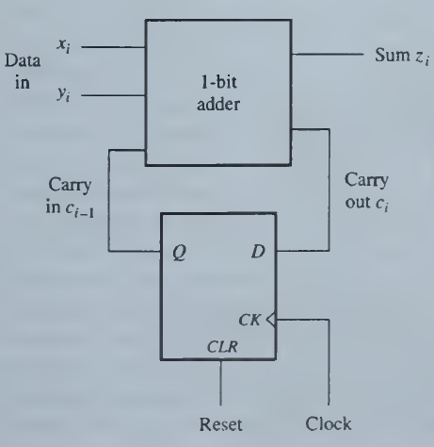
UNIT II - DATA PATH DESIGN
Addition and Subtraction:
Basic Adders
Serial Adder
The least expensive circuit in terms of hardware cost for adding two n-bit binary numbers is a serial adder.
A serial adder adds the numbers bit by bit and so requires n clock cycles to compute the complete sum of two n-bit numbers.
A serial adder consists of a full adder realizing Equations and a flip-flop to store c_{i}.
One sum bit is generated in each clock cycle; a carry is also computed and stored for use during the next clock cycle.
Advantage: Although this adder is slow, its circuit size is very small and is independent of n.
Disadvantage: Long Computation Time

Slide 6
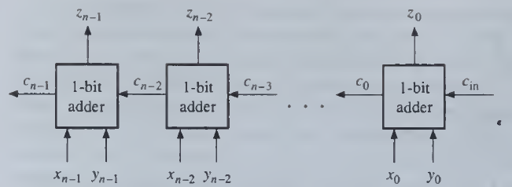
UNIT II - DATA PATH DESIGN
Addition and Subtraction:
Basic Adders
Parallel Adder

Slide 7
UNIT II - DATA PATH DESIGN
Addition and Subtraction:
Basic Adders
Parallel Adder
Circuits that, in one clock cycle, add all bits of two n-bit numbers, as well as an external carry-in signal c_{in}, are called n-bit parallel adders or simply n-bit adders.
Each 1-bit adder stage supplies a carry bit to the stage on its left.
A ‘1’ appearing on the carry-in line of a 1-bit adder can cause it to generate a ‘1’ on its carryout line.
Hence carry signals propagate through the adder from right to left, giving rise to the name ripple-carry adder. In the worst case a carry signal can ripple through all n stages of the adder.
The maximum signal propagation delay of an n-bit ripple-carry adder is nd, where d is the delay of a full-adder stage.
Disadvantage: Unlike a serial adder, the amount of hardware in a ripple-carry adder increases linearly with n, the word size of the numbers being added.
Advantage: Fast compared to Serial Adder with delay of n*FA delay.

Slide 8
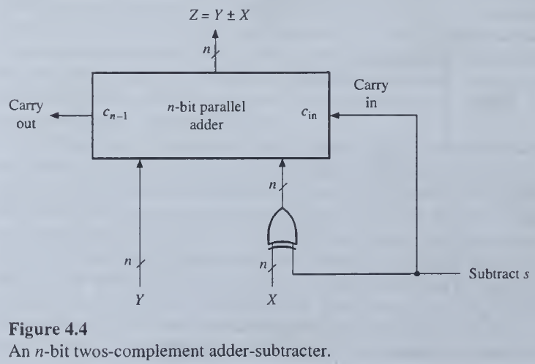
UNIT II - DATA PATH DESIGN
Addition and Subtraction:
Basic Adders
Parallel Adder / Subtracter

Slide 9
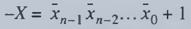
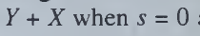
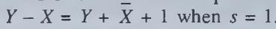
UNIT II - DATA PATH DESIGN
Addition and Subtraction:
Basic Adders
Parallel Adder / Subtracter
Thus extending a parallel adder to perform twos-complement subtraction as well as addition merely requires connecting n two-input EXCLUSIVE-OR gates to the adder's inputs; these gates are represented by a single n-bit word gate.

Slide 10
UNIT II - DATA PATH DESIGN
Addition and Subtraction:
Overflow
When the result of an arithmetic operation exceeds the standard word size n, overflow occurs.
With n-bit unsigned numbers, overflow is indicated by an output carry bit c_{n-1} = 1.
Example,
Add: X = 11101011 = 235 and Y= 00101010 = 42
Z=X+ Y= 11101011 +00101010 = 00010101=21 (235+42 (modulo 256))
with c_{n-1} = c₇ =1.
wraps around
On appending c₇ to Z, we get c₇Z =100010101 = 277 = 256+21

Slide 11
UNIT II - DATA PATH DESIGN
Addition and Subtraction:
Overflow
If we reinterpret the numbers in the preceding example as twos-complement rather than as unsigned,
Add: X = 11101011 = -21 and Y= 00101010 = 42
Z=X+ Y= 11101011 +00101010 = 00010101=+21
Overflow in modulo-2" twos-complement addition can only result from adding two positive numbers or two negative numbers.
In the first case overflow is indicated by a carry bit into the sign position, that is, by c_{n-2} = 1, since this indicates that the magnitude of the sum exceeds the n - 1 bits allocated to it.
A thought shows that overflow from adding two negative numbers is indicated by c_{n-2} = 0.
Overflow occurs if
(+A) + (+B) = −C
(−A) + (−B) = +C

Slide 12
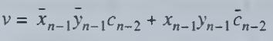
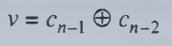
UNIT II - DATA PATH DESIGN
Addition and Subtraction:
Overflow
Overflow

Slide 13
UNIT II - DATA PATH DESIGN
Addition and Subtraction:
High Speed Adders
Carry Look Ahead Adders
Carry Save Adders
Carry Select Adders
Carry Skip Adders
Kogge-Stone Adders
Brent-Kung Adders
Ling Adders

Slide 14
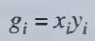
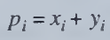

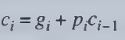
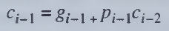
UNIT II - DATA PATH DESIGN
Addition and Subtraction:
High Speed Adders
Carry Look Ahead Adders
Generate:
Generates Carry Ci when x_{i} = y_{i} = 1
Propagate:
Propagates Carry C_{i-1} to C_{i} when x_{i} or y_{i} = 1

Slide 15
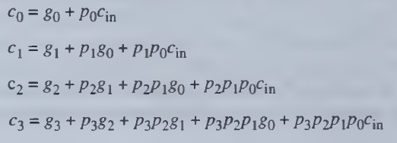
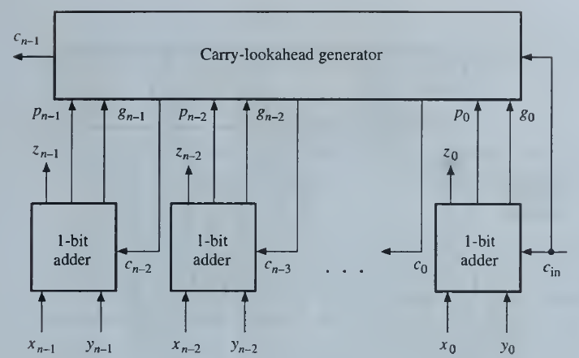
UNIT II - DATA PATH DESIGN
Addition and Subtraction:
High Speed Adders
Carry Look Ahead Adders
Advantages:
Speed of Computation is High
Disadvantages:
The Number of Gates required grows as n2 for n bits. So, maximum of 4-bit CLA is used.

Slide 16
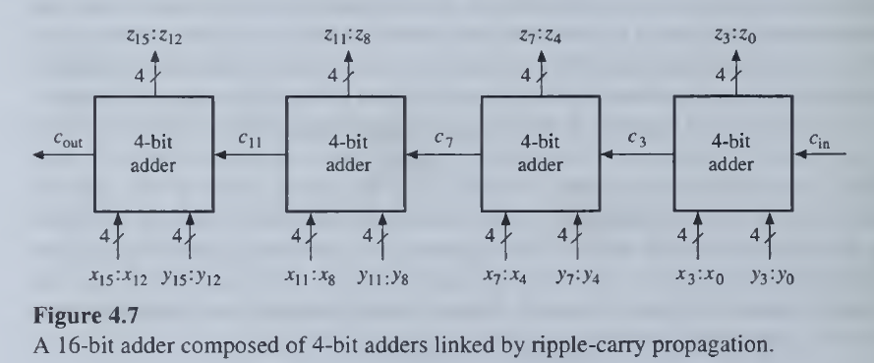
UNIT II - DATA PATH DESIGN
Addition and Subtraction:
High Speed Adders
Adder Expansion
16 bit Adder = 4 Cascaded CLA with RCA carry propagation or CLA Generator with RCA

Slide 17
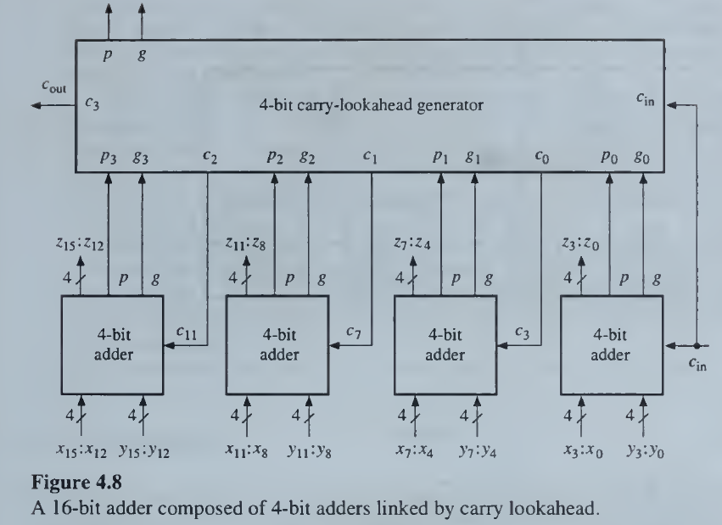
UNIT II - DATA PATH DESIGN
Addition and Subtraction:
High Speed Adders
Adder Expansion
16 bit Adder = 4 Cascaded CLA with RCA carry propagation or CLA Generator with RCA

Slide 18
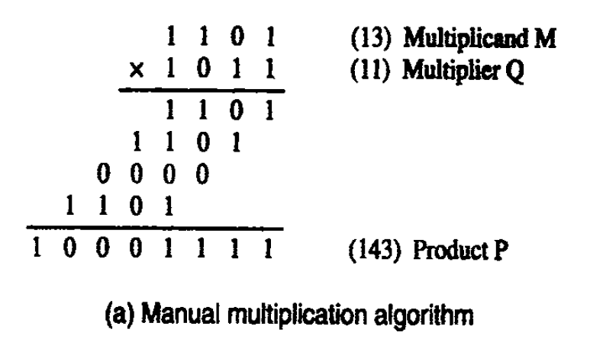
UNIT II - DATA PATH DESIGN
Multiplication:
Multiplication of Positive Numbers – Array Multiplier

Slide 19
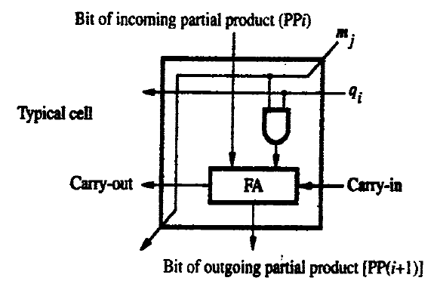
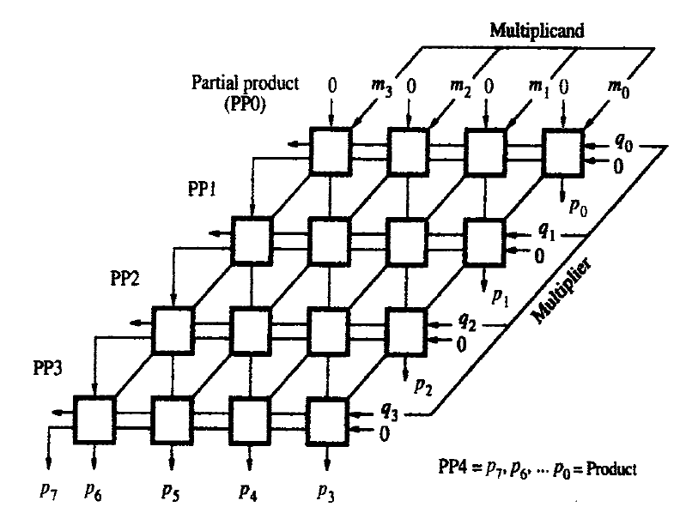
UNIT II - DATA PATH DESIGN
Multiplication:
Multiplication of Positive Numbers – Array Multiplier

Slide 20
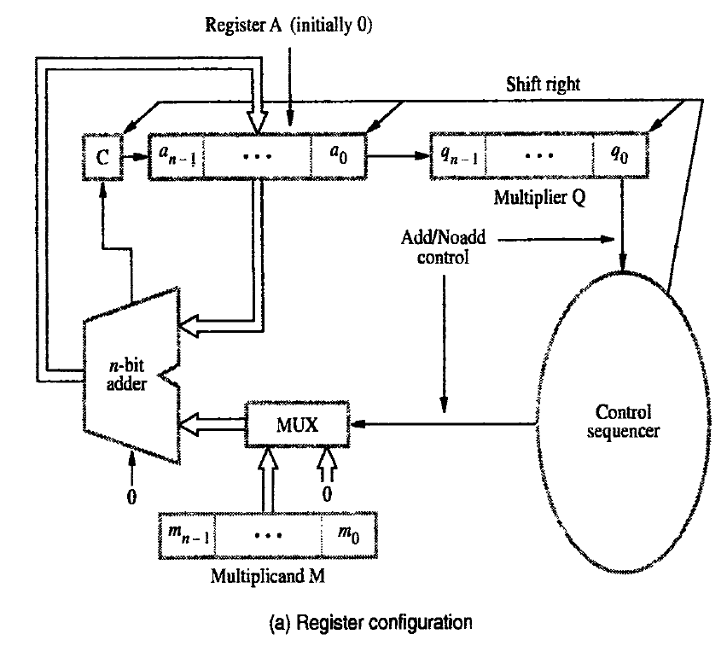
UNIT II - DATA PATH DESIGN
Multiplication:
Multiplication of Positive Numbers – Array Multiplier

Slide 21
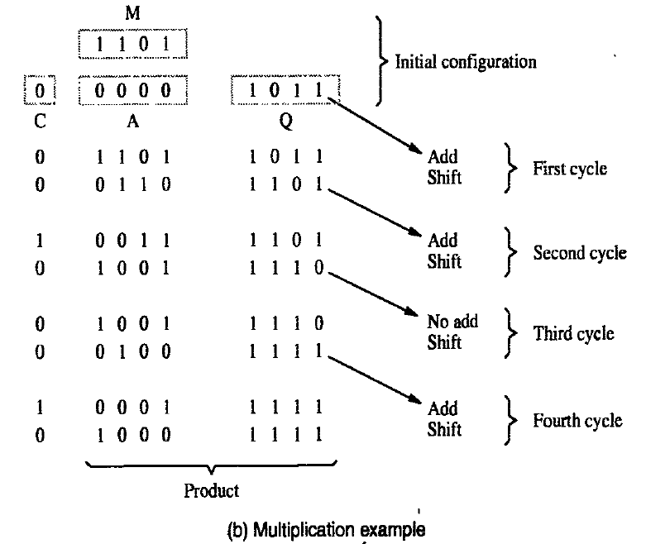
UNIT II - DATA PATH DESIGN
Multiplication::
Multiplication of Positive Numbers – Array Multiplier

Slide 22
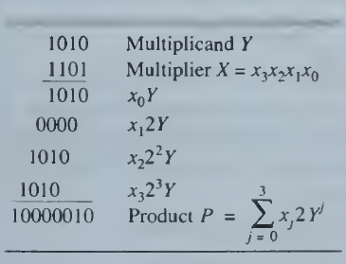
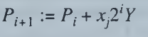
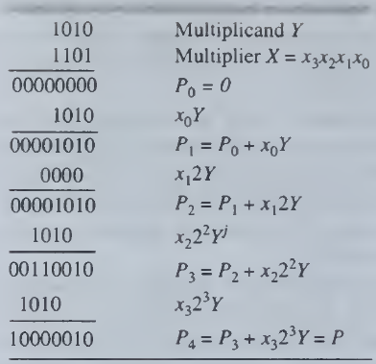
UNIT II - DATA PATH DESIGN
Multiplication:
2’s Complement Multiplier

Slide 23
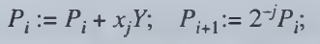
UNIT II - DATA PATH DESIGN
Multiplication:
2’s Complement Multiplier
In Machine Level, the Partial Products are shifted Right instead of Left, hence
The Sign bit is calculated as Ps = Xs xorYs

Slide 24
UNIT II - DATA PATH DESIGN
Multiplication:
2’s Complement Multiplier
It has common procedure for ,
Integers and Fractions
Positive and Negative Numbers
During the right shifting the SIGN bit has to be Preserved
When multiplier is negative n-th step is Subtraction (A-M) and Right Shift.

Slide 25
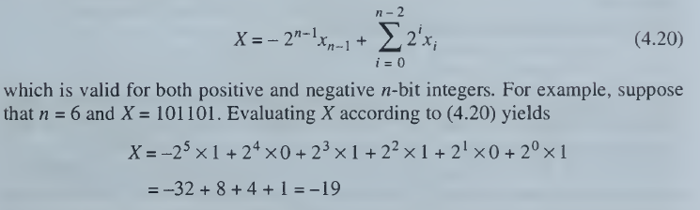
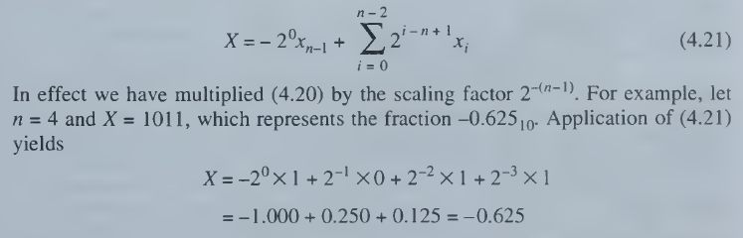
UNIT II - DATA PATH DESIGN
Multiplication:
2’s Complement Multiplier

Slide 26
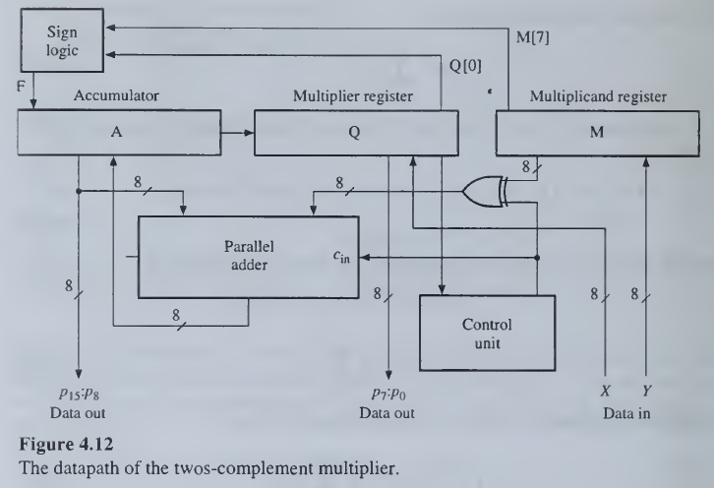
UNIT II - DATA PATH DESIGN
Multiplication:
2’s Complement Multiplier

Slide 27
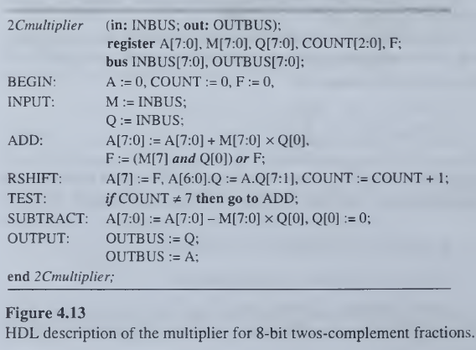
UNIT II - DATA PATH DESIGN
Multiplication:
2’s Complement Multiplier
Algorithm
Initially, Multiplicand in M Register; Multiplier in Q Register; Accumulator is Cleared.
If Q(0)=1, then A = A + M and Right Shift FAQ.
Else if Q(0)=0, then A = A + 0 and Right Shift FAQ.
(During the Right Shift retain the Sign Bit value)
Do this for n-bits, n times.

Slide 28
UNIT II - DATA PATH DESIGN
Multiplication:
2’s Complement Multiplier
Four Possible cases based on the Sign of X (Multiplier) and Y (Multiplicand):
X₇=Y₇=0; (X=Y= Positive)
Do the Algorithm for ‘n’ times.
X₇=0, Y₇=1; (X= Positive, Y= Negative)
Do the Algorithm for ‘n’ times and retain the sign bits.
X₇=1, Y₇=0; (X= Negative , Y= Positive)
Do the Algorithm for ‘n-1’ times and at the ‘n’th step do A=A-M and Right Shift (It is a Correction Step).
X₇=1, Y₇=1; (X=Y= Negative)
Do the Algorithm for ‘n-1’ times and at the ‘n’th step do A=A-M and Right Shift (It is a Correction Step).
Sign Flag: F = (Y₇ and X_{i}) or F

Slide 29
UNIT II - DATA PATH DESIGN
Multiplication:
2’s Complement Multiplier - Example
Multiplier X = 1011 0011 (-77)
Multiplicand Y = 1101 0101 (-43)
2’ Complement of Y = 0010 1011

Slide 30
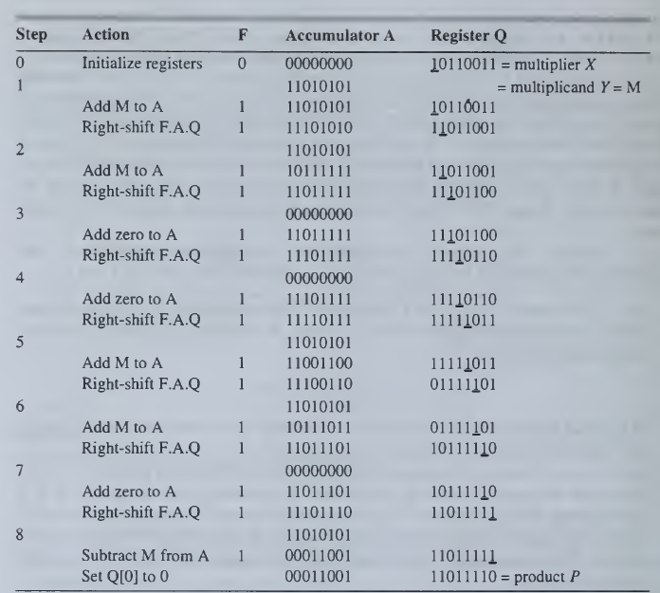
UNIT II - DATA PATH DESIGN
Multiplication:
2’s Complement Multiplier - Example

Slide 31
UNIT II - DATA PATH DESIGN
Multiplication:
2’s Complement Multiplier – Home Work
X = 1011 0011; Y = 0101 0101
X = 1100 (-4); Y = 0101 (5)
X = 1100 (-4); Y = 1101 (-3)
X = 0101 (5); Y = 1101 (-3)
X = 1011 (-5); Y = 1101 (-3)
Ans: 1010 0001 1101 1110
Ans: 1110 1100 (-20)
Ans: 0000 1100 (+13)
Ans: 1111 0001 (-15)
Ans: 0000 1111 (+15)

Slide 32
UNIT II - DATA PATH DESIGN
Signed Operand Multiplication:
Booth Multiplication
Modified Booth Multiplication
The significant operations are,
Sign Bit Extension
Booth or Bit Pair recorded Multiplier
Subtraction by 2’s Complement Addition

Slide 33
UNIT II - DATA PATH DESIGN
Signed Operand Multiplication:
Booth Multiplier
Rules
The multiplicand is subtracted from the partial product upon encountering the first least significant 1 in a string of 1’s in the multiplier
The multiplicand is added to the partial product upon encountering the first 0 (provided that there was a previous ‘1’ in a string of 0’s in the multiplier.
The partial product does not change when the multiplier bit is identical to the previous multiplier bit.

Slide 34
UNIT II - DATA PATH DESIGN
Signed Operand Multiplication:
Booth Multiplier
Rules
Multiplier |  | Booth Multiplier
Bit (Qi) | Bit (Qi-1) | (Q)×M
0 | 0 | 0 × M
0 | 1 | +1 × M
1 | 0 | -1 × M (2’s Complement Addition)
1 | 1 | 0 × M

Slide 35
UNIT II - DATA PATH DESIGN
Signed Operand Multiplication:
Booth Multiplier
Algorithm
Set the Multiplicand and Multiplier binary bits as M and Q, respectively.
Initially, we set the AC and Q_{n + 1} registers value to 0.
SC represents the number of Multiplier bits (Q), and it is a sequence counter that is continuously decremented till equal to the number of bits (n) or reached to 0.
A Qn represents the last bit of the Q, and the Q_{n+1} shows the incremented bit of Qn by 1.
On each cycle of the booth algorithm, Q_{n} and Q_{n + 1} bits will be checked on the following parameters as follows:
When two bits Q_{n} and Q_{n + 1} are 00 or 11, we simply perform the arithmetic shift right operation (ashr) to the partial product AC. And the bits of Qn and Q_{n + 1} is incremented by 1 bit.
If the bits of Q_{n} and Q_{n + 1} is shows to 01, the multiplicand bits (M) will be added to the AC (Accumulator register). After that, we perform the right shift operation to the AC and QR bits by 1.
If the bits of Q_{n} and Q_{n + 1} is shows to 10, the multiplicand bits (M) will be subtracted from the AC (Accumulator register). After that, we perform the right shift operation to the AC and QR bits by 1.
The operation continuously works till we reached n - 1 bit in the booth algorithm.
Results of the Multiplication binary bits will be stored in the AC and QR registers.

Slide 36
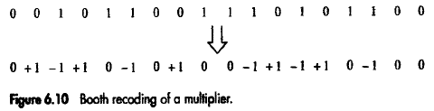
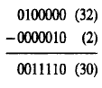
UNIT II - DATA PATH DESIGN
Signed Operand Multiplication:
Booth Multiplier
0011110 can be written as

Slide 37
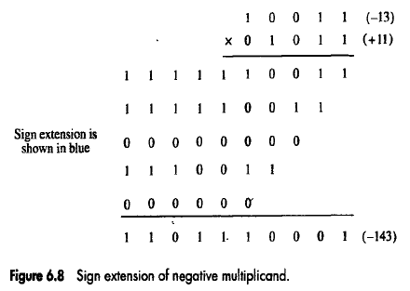
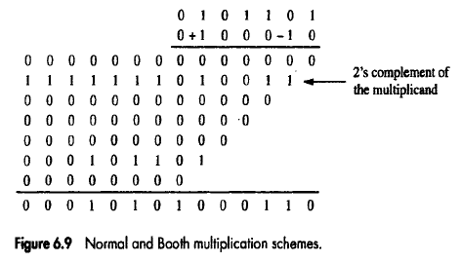
UNIT II - DATA PATH DESIGN
Signed Operand Multiplication:
Booth Multiplier - Examples

Slide 38
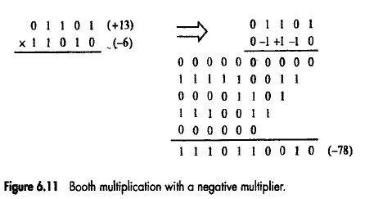
UNIT II - DATA PATH DESIGN
Signed Operand Multiplication:
Booth Multiplier - Examples

Slide 39
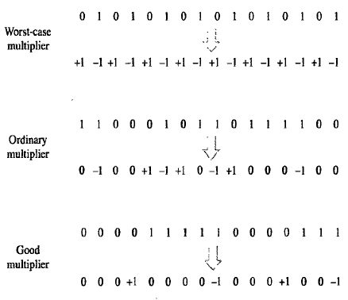
UNIT II - DATA PATH DESIGN
Signed Operand Multiplication:
Booth Multiplier
Worst and Best Case
Best case is when there is a large block of consecutive 1’s and 0’s in the multipliers, so that there is minimum number of logical operations taking place, as in addition and subtraction.
Worst case is when there are pairs of alternate 0’s and 1’s, either 01 or 10 in the multipliers, so that maximum number of additions and subtractions are required.

Slide 40
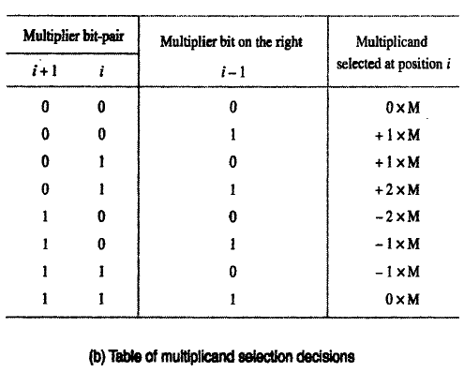
UNIT II - DATA PATH DESIGN
Signed Operand Multiplication:
Modified Booth (Bit-Pair recoding) Multiplier
This is derived from the Booth’s algorithm. It pairs the multiplier bits and gives one multiplier bit per pair, thus reducing the number of summands by half.

Slide 41
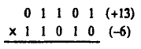
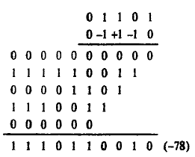
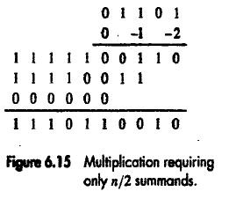
UNIT II - DATA PATH DESIGN
Signed Operand Multiplication:
Modified Booth (Bit-Pair recoding) Multiplier

Slide 42
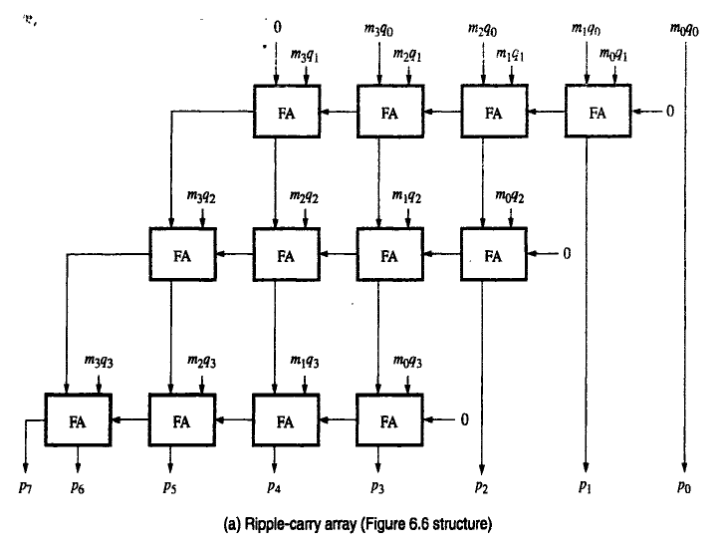
UNIT II - DATA PATH DESIGN
Signed Operand Multiplication:
Carry Save Addition

Slide 43
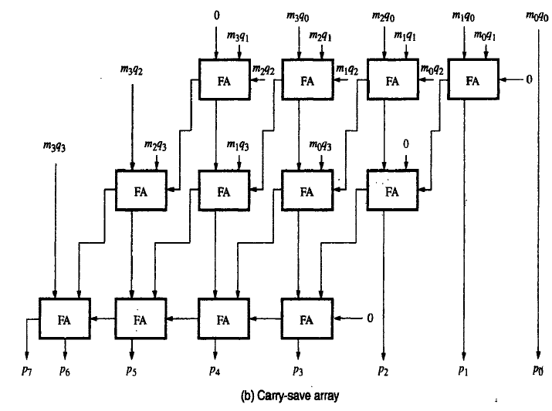
UNIT II - DATA PATH DESIGN
Signed Operand Multiplication:
Carry Save Addition

Slide 44
UNIT II - DATA PATH DESIGN
Signed Operand Multiplication:
Carry Save Addition

Slide 45
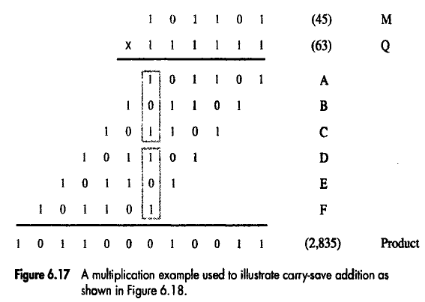
UNIT II - DATA PATH DESIGN
Signed Operand Multiplication:
Carry Save Addition
Carry save adders (CSA) speed up the addition of the summands generated during the multiplication process. The inputs to a full adder are normally the two bits of the two numbers and the carry input from the previous stage.
On the other hand, in the case of the CSA, all the three bits are taken from the three numbers. The carry generated is saved and added at the next level. A CSA takes in two inputs and outputs two outputs.

Slide 46
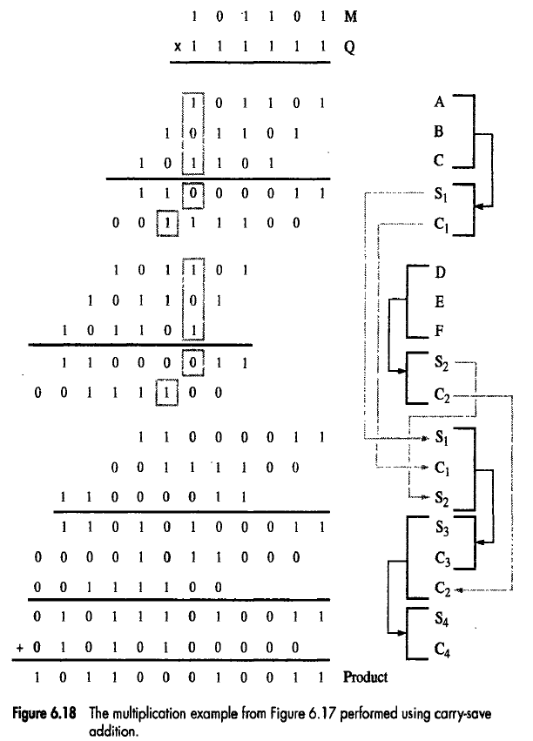
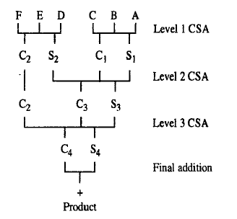
UNIT II - DATA PATH DESIGN
Signed Operand Multiplication:
Carry Save Addition

Slide 47
UNIT II - DATA PATH DESIGN
Signed Operand Multiplication:
Thus, in order to speed up the multiplication process, bit-pair recoding of the multiplier is used to reduce the summands. These summands are then reduced to 2 using a few CSA steps.
The final product is generated by an addition operation that uses CLA.
All these three techniques help in reducing the time taken for multiplication.

Slide 48
UNIT II - DATA PATH DESIGN
Integer Division:
Slow Division
Restoring Algorithm
Non-Restoring Algorithm
SRT division
Fast Division
Newton–Raphson division
Goldschmidt division

Slide 49
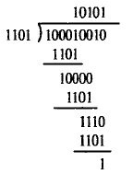

UNIT II - DATA PATH DESIGN
Integer Division:
The divisor is appropriately positioned w.r.t. the dividend.
Subtraction is performed.
If the remainder is,
Zero or Positive – a quotient bit is ‘1’. The remainder is extended by another bit of the dividend. The divisor is repositioned and perform subtraction.
Negative – quotient bit ‘0’. The dividend is restored by adding back the divisor. The divisor is repositioned and perform subtraction.

Slide 50

UNIT II - DATA PATH DESIGN
Integer Division:

Slide 51
UNIT II - DATA PATH DESIGN
Integer Division: Restoring Division
n-bit positive divisor is loaded into register M .
n-bit positive dividend is loaded into register Q.
Register A is set to ‘0’.
After Division, n-bit Quotient is in register Q; remainder is in register A.
Subtraction done by 2’s Complement addition.
The MSB of A and M indicates the sign bit during the subtractions.
Algorithm (Do the following for ‘n’ times)
Shift A and Q left one binary position.
Subtract M from A (A=A-M), and place the answer back in A.
If the sign of A is 1, set q₀ = 0 and add M back to A (A=A+M) (ie. Restore A); else if A is 0, set q₀ = 1.

Slide 52

UNIT II - DATA PATH DESIGN
Integer Division: Restoring Division

Slide 53


UNIT II - DATA PATH DESIGN
Integer Division: Restoring Division

Slide 54
UNIT II - DATA PATH DESIGN
Integer Division: Non-Restoring Division
The restoring algorithm is improved by avoiding the need for RESTORE after every unsuccessful subtractions. That means the result is negative.
If A is Positive, we shift left and subtract M; i.e. 2A – M.
If A is Negative, we restore by A + M and left shift (i.e 2A + 2M); then subtract M. This is equivalent to 2A + M.
q₀ is set to ‘0’ or ‘1’ after the correct operatioon.

Slide 55
UNIT II - DATA PATH DESIGN
Integer Division: Non-Restoring Division
Algorithm
Step 1:
Do the following for ‘n’ times:
If the sign of A is 0, then Shift A and Q left one binary position and Subtract M from A (A=A-M), otherwise shift A and Q left and add M to A (A=A+M).
If the sign of A is 0, set q₀ = 1; else if A is 1, set q₀ = 0.
Step 2:
If the sign of A is 1, add M to A (A=A+M).

Slide 56


UNIT II - DATA PATH DESIGN
Integer Division: Non-Restoring Division
Step 2 is needed to provide proper positive remainder in A at the end of ‘n’ cycles.
Restore operation at every cycle is not needed; one ADD or SUBTRACT operation is performed per cycle.

Slide 57
UNIT II - DATA PATH DESIGN
Arithmetic Logic Circuits
The various circuits used to execute data-processing instructions are usually combined in a single circuit called an arithmetic-logic unit or ALU.
The complexity of an ALU is determined by the way in which its arithmetic instructions are realized. Simple ALUs that perform fixed-point addition and subtraction, as well as word based logical operations, can be realized by combinational circuits.
ALUs that also perform multiplication and division.
Some processors having fixed-point ALUs employ special-purpose auxiliary units called arithmetic (co)processors to perform floating-point and other complex numerical functions.

Slide 58

UNIT II - DATA PATH DESIGN
Arithmetic Logic Circuits – Combinational ALU

Slide 59
UNIT II - DATA PATH DESIGN
Arithmetic Logic Circuits – Combinational ALU
The simplest ALUs combine the functions of a twos-complement adder-subtracter with those of a circuit that generates word-based logic functions of the form f(X,Y), for example, AND, XOR, and NOT.
They can thus implement most of a CPU‘s fixed-point data-processing instructions.
Figure 4.28 outlines an ALU that has separate subunits for logical and arithmetic operations. The particular class of operation (logical and arithmetic) to be performed is determined by a "mode" control line M attached to a two-way multiplexer that channels the required result to the output bus Z.
The specific operation performed by the desired subunit is determined by a "select" control line S. The ALU's logical operations are performed bitwise; that is, the same operation / is applied to every pair of data lines x_{i}y_{j}.
The maximum number of distinct logical operations is 16, which is the number of distinct truth tables of two Boolean variables. Hence the select bus S needs to be of size 4.
S can also be used to select up to 16 different arithmetic operations such as X + Y, X - Y, Y - X, X + 1 (increment), X- 1 (decrement), and so on, as needed.

Slide 60



UNIT II - DATA PATH DESIGN
Arithmetic Logic Circuits – Combinational ALU

Slide 61
UNIT II - DATA PATH DESIGN
Arithmetic Logic Circuits – Sequential ALUs
Although, both multiplication and division can be implemented by combinational logic, it is generally impractical to merge these operations with addition and subtraction into a single, combinational ALU.
The reason is twofold.
Combinational multipliers and dividers are costly in terms of hardware. They are also much slower than addition and subtraction circuits, a consequence of their many logic levels.
An n-bit combinational multiplier or divider is typically composed of n or more levels of add-subtract logic, making multiplication and division at least n times slower than addition or subtraction.
The number of gates in the multiply-divide logic is also greater by a factor of about n. Hence except when n is very small, complete ALUs are usually constructed from low-cost sequential circuits where add and subtract each take one clock cycle, while multiplication and division are multi-cycle operations.

Slide 62

UNIT II - DATA PATH DESIGN
Arithmetic Logic Circuits – Sequential ALUs

Slide 63

UNIT II - DATA PATH DESIGN
Arithmetic Logic Circuits – Sequential ALUs
Three one-word registers are used for operand storage: the accumulator AC, the multiplier-quotient register MQ. and the data register DR.
AC and MQ are organized as a single register AC.MQ capable of left- and right-shifting. Additional data processing is provided by a combinational ALU capable of addition, subtraction, and logical operations; we will refer to this unit as the add-subtract unit.
This unit derives its inputs from AC and DR and places its results in AC. The MQ register is so-called because it stores the multiplier during multiplication and the quotient during division.
DR stores the multiplicand or divisor, while the result (product or quotient and remainder) is stored in the register-pair AC.MQ.

Slide 64

UNIT II - DATA PATH DESIGN
Arithmetic Logic Circuits – Sequential ALUs
Register files:
Modern CPUs retain special registers like the multiplier-quotient register MQ for multiplication and division, but the accumulator AC and the data register DR are usually replaced by a set of general-purpose registers.

Slide 65
UNIT II - DATA PATH DESIGN
Arithmetic Logic Circuits – Sequential ALUs
ALU expansion:
It is quite feasible to manufacture an entire sequential ALU for fixed-point w-bit numbers on a single IC chip.
Moreover, the ALU can easily be designed for expansion to handle operands of size n = km, or indeed any word size n > m, in two ways:
Spatial expansion: Connect k copies of the m-bit ALU in the manner of a ripple- carry adder to form a single ALU capable of processing km-bit words directly. The resulting array-like circuit is said to be bit sliced because each component ALU concurrently processes a separate "slice" of m bits from each km-bit operand.
Temporal expansion: Use one copy of the m-bit ALU chip in the manner of a serial adder to perform an operation on km-bit words in k consecutive steps (clock cycles). In each step the ALU processes a separate m-bit slice of each operand. This processing is called multi-cycle or multiple-precision processing.

Slide 66


UNIT II - DATA PATH DESIGN
Arithmetic Logic Circuits – Sequential ALUs

Slide 67

UNIT II - DATA PATH DESIGN
Floating Point Arithmetic Operations
Let (X_{M}, X_{E}) be the floating-point representation of a number X, which therefore has the numerical value X_{M} x B^{X}_{E} .
Recall that the mantissa (significant) X_{M} and the exponent X_{E} are fixed-point numbers and that the base B is the same as the base (radix) of X_{M}.

Slide 68

UNIT II - DATA PATH DESIGN
Floating Point Arithmetic Operations – Basic Operations
Example:
X = 1.32400111 x 10¹⁷ and Y = 1.04799245 x 10²¹
X x Y is given by
(1.32400111 x 1.04799245) x 10⁽¹⁷ ⁺ ²¹⁾ = 1.38758607 x 10³⁸
Floating-point division requires a fixed-point division involving the mantissas and a fixed-point subtraction involving the exponents.
Thus multiplication and division are not much harder to implement than the corresponding fixed-point operations.

Slide 69


UNIT II - DATA PATH DESIGN
Floating Point Arithmetic Operations – Basic Operations
Floating-point addition and subtraction are complicated by the fact that the exponents of the two input operands must be made equal before the corresponding mantissas can be added or subtracted.
As suggested by Figure 4.40, this exponent equalization can be done by right- shifting the mantissa X_{M} associated with the smaller exponent X_{E} a total of Y_{E} - X_{E} digit positions to form a new mantissa X_{M}2^{X}_{E}^{-Y}_{E}, which can then be combined directly with Y_{M}.
Thus floating-point addition and subtraction have three main steps:

Slide 70



UNIT II - DATA PATH DESIGN
Floating Point Arithmetic Operations – Basic Operations

Slide 71
UNIT II - DATA PATH DESIGN
Floating Point Arithmetic Operations – Difficulties
If biased exponents are added or subtracted using fixed-point arithmetic in the course of a floating-point calculation, the resulting exponent is doubly biased and must be corrected by subtracting the bias.
For example, let the exponent length be 4, and let the bias be 2⁴⁻¹ = 8.
Suppose that exponents X_{E} = 1111 and Y_{E} = 0101 denoting +7 and -3, respectively, are to be added. If ordinary binary addition is used, we obtain the sum X_{E} + Y_{E} = 10100, which denotes 12 = 4 + 8 in excess-8 code.
The sum 10100 is now corrected by subtracting the bias 1000 to produce 1100, which is the correct biased representation of X_{E} + Y_{E} = 4.
Another problem arises from the all-0 representation usually required of zero.
If X x Y is computed as (X_{M} x Y_{M}) x 2^{XE + YE} and either X_{M} or Y_{M} is zero, the resulting product has an all-0 mantissa but may not have an all-0 exponent.
A special step is then needed to make the exponent bits 0.

Slide 72

UNIT II - DATA PATH DESIGN
Floating Point Arithmetic Operations – Difficulties
A floating-point operation causes overflow or underflow if the result is too large or too small to be represented. Overflow or underflow resulting from mantissa operations can usually be corrected by shifting the mantissa of the result and modifying its exponent; this is done automatically during floating-point processing.
For instance, adding the normalized decimal numbers X = 5.1049 x 10⁷ and Y = 7.9379 x 10⁷ produces the sum 13.0428 x 10⁷ . which is normalized to 1.3043 x 10⁸ by shifting X_{M} one digit to the right (and rounding off the result) and incrementing the exponent by one.
To preserve accuracy during floating-point calculations, one or more extra bits called guard bits are temporarily attached to the right end of the mantissa

Slide 73

UNIT II - DATA PATH DESIGN
Floating Point Arithmetic Operations – Guard Bits
The additional bits are to be added into the LSB of the operands in order to improve the accuracy during arithmetic operations, which are named as Guard Bits.
The Precision of the Final result is improved due to Guard Bits.

Slide 74
UNIT II - DATA PATH DESIGN
Floating Point Arithmetic Operations – Truncation
The Process of removing the Guard bits after the arithmetic operations is named as “Truncation”
Three methods of Truncation :
Chopping
Von Neumann Rounding
Rounding

Slide 75
UNIT II - DATA PATH DESIGN
Floating Point Arithmetic Operations – Truncation
Chopping
Remove all the Guard bits and retain the specified size of the bits. It is a Biased Approximations.
Ex.: 0.010101 → 0.010
Error Range is : 0.00000 to 0.000111
Von Neumann Chopping
If the removed bits consists of ‘1’ then LSB of the retained bits are increased by ‘1’. It is a UnBiased Approximations.
Ex.: 0.010101 → 0.011
Error Range is : -1 to +1
Rounding
If the removed bits MSB consists of ‘1’ then LSB of the retained bits are incremented by ‘1’. Otherwise, no increment. It is a UnBiased Approximations.
Ex.: 0.010101 → 0.011; 0.010011 → 0.010
Error Range is : -(1/2) to +(1/2)

Slide 76

UNIT II - DATA PATH DESIGN
Floating Point Addition/Subtraction:

Slide 77
UNIT II - DATA PATH DESIGN
Floating Point Addition/Subtraction:
Floating-point arithmetic can be implemented by two loosely connected fixed-point data path circuits, an exponent unit and a mantissa unit. The mantissa unit performs all four basic operations on the mantissas.
A simpler circuit capable of only adding, subtracting, and comparing exponents suffices for the exponent unit. Exponent comparison can be done by a comparator or by subtracting the exponents.
Figure 4.41 outlines the structure of a floating-point unit employing the foregoing approach. The exponents of the input operands are put in registers El and E2, which are connected to an adder that computes El + E2.
The exponent comparison required for addition and subtraction is made by computing El - E2 and placing it in a counter register E. The larger exponent is then determined from the sign of E. The shifting of one mantissa required before the mantissa addition or subtraction can occur is controlled by E. The magnitude of E is sequentially decremented to zero.
After each decrement, the appropriate mantissa (whose location in the mantissa unit varies with the operation being performed) is shifted one digit position. Once the mantissas have been aligned, they are processed in the usual manner. The exponent of the result is also computed and placed in E.

Slide 78

UNIT II - DATA PATH DESIGN
Floating Point Addition/Subtraction: Architecture

Slide 79
UNIT II - DATA PATH DESIGN
Floating Point Addition/Subtraction:
The mantissa is assumed to be a binary fraction, and the exponent a biased integer; the base B is 2.
The first step of the algorithm is equalization of the exponents, which is done by subtracting them and aligning the mantissas by shifting one of them until the difference between the exponents has been reduced to zero.
Next the aligned mantissas are added.
Finally the result is normalized, if necessary, by again shifting the mantissa and making a compensating change in the exponent.
The mantissa and exponent of the final result are placed in the AC and E registers, respectively.
Tests are also performed for floating-point overflow and underflow; if either occurs, a flag ERROR is set to 1.
A separate test is made for a zero result which, if indicated by AC = 0, causes E to be set to also.

Slide 80
UNIT II - DATA PATH DESIGN
Floating Point Addition/Subtraction:
Special Cases:
We can save time by checking to see whether one of the input operands X or Y is zero at the start and simply making the nonzero operand the result.
If both X and Y are zero, either operand may be used as the result.
If the difference between exponents is very large (|E| > n_{M}), then the shifting process to align one of the mantissas, say, X_{M} in AC, will result in AC = 0, after n_{M} steps. Continued shifting to make E = 0 will not affect the result, which in this case will be Y_{M}. Note also that it is more efficient to terminate the shifting after n_{M} steps instead of |EI|steps,

Slide 81


UNIT II - DATA PATH DESIGN
Floating Point Addition/Subtraction: Example
The numbers have the 32-bit format of the IEEE Standard 754.
In this format each number N has a 23-bit fractional mantissa M with a hidden bit. an 8-bit exponent E in excess- 127 code, and
A base B = 2.

Slide 82
UNIT II - DATA PATH DESIGN
Floating Point Addition/Subtraction: Example
The exponent subtraction X_{E} – Y_{E} in the COMPARE step is done using excess-127 code and produces 11110111 = -8₁₀.
Note that a in the left-most bit position of E always indicates a negative number in this code.
Now the EQUALIZE step is executed, causing E to be incremented and AC, which contains the mantissa of X (including its hidden bit), to be right-shifted.
After eight shifts, E reaches zero, indicated by its left-most bit changing from to 1.
Then the mantissa addition takes place, and the larger exponent is transferred from E_{l} to E.
The sum appearing in AC is normalized, so the final result X + Y = 300.75₁₀ has its exponent in E and its mantissa in AC.
The sum is eventually stored in the following standard format.
X+Y=0 10000111 00101100110000000000000

Slide 83

UNIT II - DATA PATH DESIGN
Floating Point Addition/Subtraction: Example

Slide 84





UNIT II - DATA PATH DESIGN
Floating Point Addition/Subtraction:
Architecture

Slide 85
UNIT II - DATA PATH DESIGN
Floating Point Addition/Subtraction:
Architecture

Slide 86
https://www.geeksforgeeks.org/overflow-in-arithmetic-addition-in-binary-number-system/
http://vlabs.iitkgp.ernet.in/coa/exp7/index.html
http://www.ecs.umass.edu/ece/koren/arith/simulator/Booth/ (Simulator)

Slide 87



Slide 88

https://kodlogs.com/98992/restoring-and-non-restoring-division-algorithm-with-example
Non-restoring division
Set Register A = Dividend = 000000
Set Register Q = Dividend = 101110 ( So AQ = 000000 101110 , Q0 = LSB of Q = 0 ) Set M = Divisor = 010111, M' = 2's complement of M = 101001
Set Count = 6, since 6 digits operation is being done here.

